Slide 1
Agenda for GEOG260/360 GIS & Land Change Models
November 6
Discuss Project Proposals
10-minute mingle to for groups to meet
November 8
Submit Project Proposal by 4pm on Canvas
Exam Preparation & Readings
November 13
Feedback on Proposals
Exam Preparation & Readings
November 15 Deadline for abstracts submitted to https://www.aag.org/events/aag2024/
Exam Preparation & Readings
November 20
In Class Exam
November 27 to December 11, which is the last day to withdraw from the course
Project Presentations
December 18 during Final Exam time slot 6:30-8:30pm
Make-up project presentation time slot in case a project presentation must be postponed
December 13
Project PPTX file due
December 20
Project Product due

Slide 3
Baseline Simulation (Run1)
This slide shows the Baseline Simulation where the REDD project modeler was calibrated from 2005-2010 and extrapolated to the year 2040.
This map specifically shows whether the unconstrained, simulated deforestation is to occur within or outside of the project area.
To the right is the reference map showing forested area, the project (protected) area, and the forest loss during each time interval.
To the left is the projected land cover for 2040 with no constraints on deforestation.
The CrossTab between the baseline simulation and the reference map shows where forest is simulated to persist, where deforestation occurred from 2005-2010, and where deforestation is simulated to occur by 2040.

Slide 4
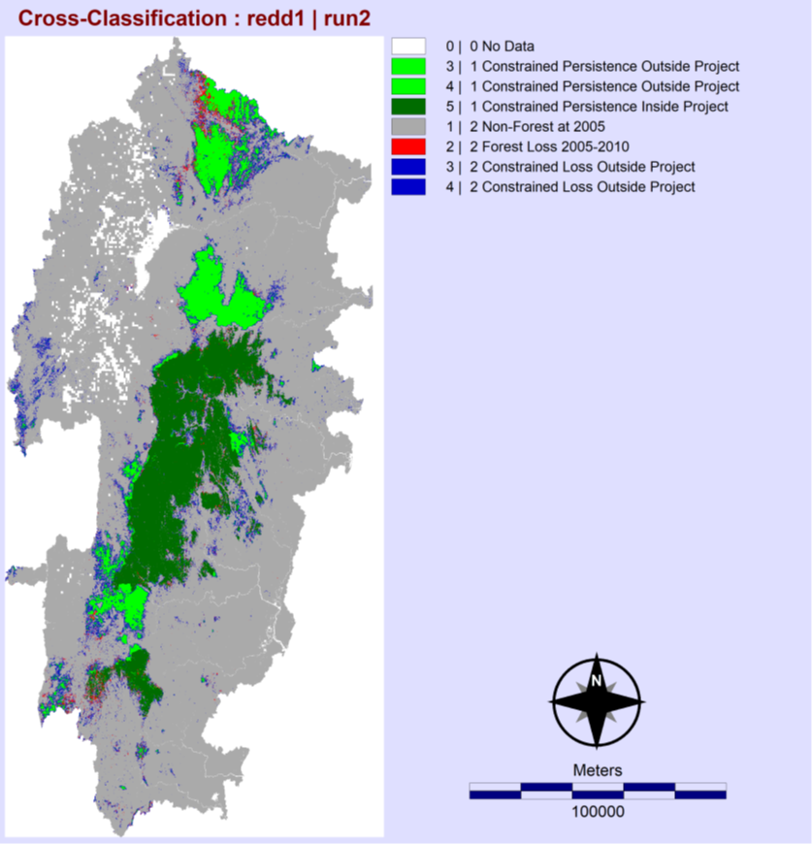
Constrained Simulation (Run2)
This is the constrained run, in which the simulated deforestation was not able to occur within the project area
Below is the projected land cover for 2040 with deforestation banned within the project area
The CrossTab is between the constrained simulation and the reference map, showing where deforestation is simulated to occur when not allowed to occur in the protected region.
The quantity of forest loss is the same, but the deforestation that occurred within the project area in the baseline simulation are displaced to outside of the project in this run.

Slide 5
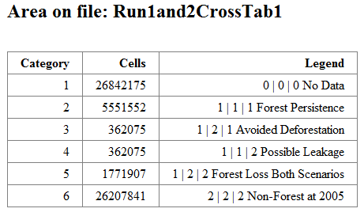
Baseline VS Constrained
Forest Persistence (green) is where forest remains from 2005-2010 and is simulated to remain from 2010-2040.
Avoided Deforestation (yellow) is where there was simulated forest loss inside of the project area during the baseline (362075 pixels) (the yellow pixels in slide 2)
Possible leakage (red) is the forest loss (362075 pixels) that was simulated inside the project in the baseline simulation, that had to be displaced in the constrained simulation
Forest Loss in Both Scenarios is where forest loss would occur, with or without a constraint on the project area

Slide 6
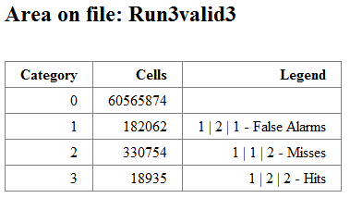
Validation and Figure of Merit
Below is the final run, which was extrapolated only to 2013. The purpose of this run was to extrapolate to a year that we had data for so that we could do a validation. The validation was so that we could retrieve the number of false alarms, misses, and hits so that we could calculate the figure of merit.
Figure of Merit = Hits / (Misses + Hits + False Alarms)
18935 / (330754 + 18935 + 182062)
FOM = 0.035560877
According to the Voluntary Carbon Standard, the simulation model qualifies when the FOM > |Forest Loss during calibration| / Forest start size
|346573| / 8047609 = 0.04306534
0.035560877 < 0.04306534
Because the figure of merit is less than the proportion of forest loss during the calibration interval, this model does not qualify for a REDD project
The only variables for this model were the distance from non-forest and the protected areas in run 2.
Options for improving the Figure of Merit could include adding variables such as land use types, elevations, and where built/urban areas are.

Slide 7
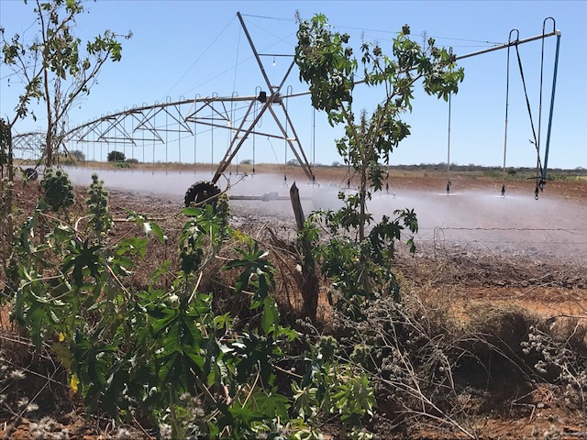
Clark Professors Pontius and Oliveria earned a $750,000 grant from NASA to study irrigation in Brazil as an adaption to climate change.

Slide 8
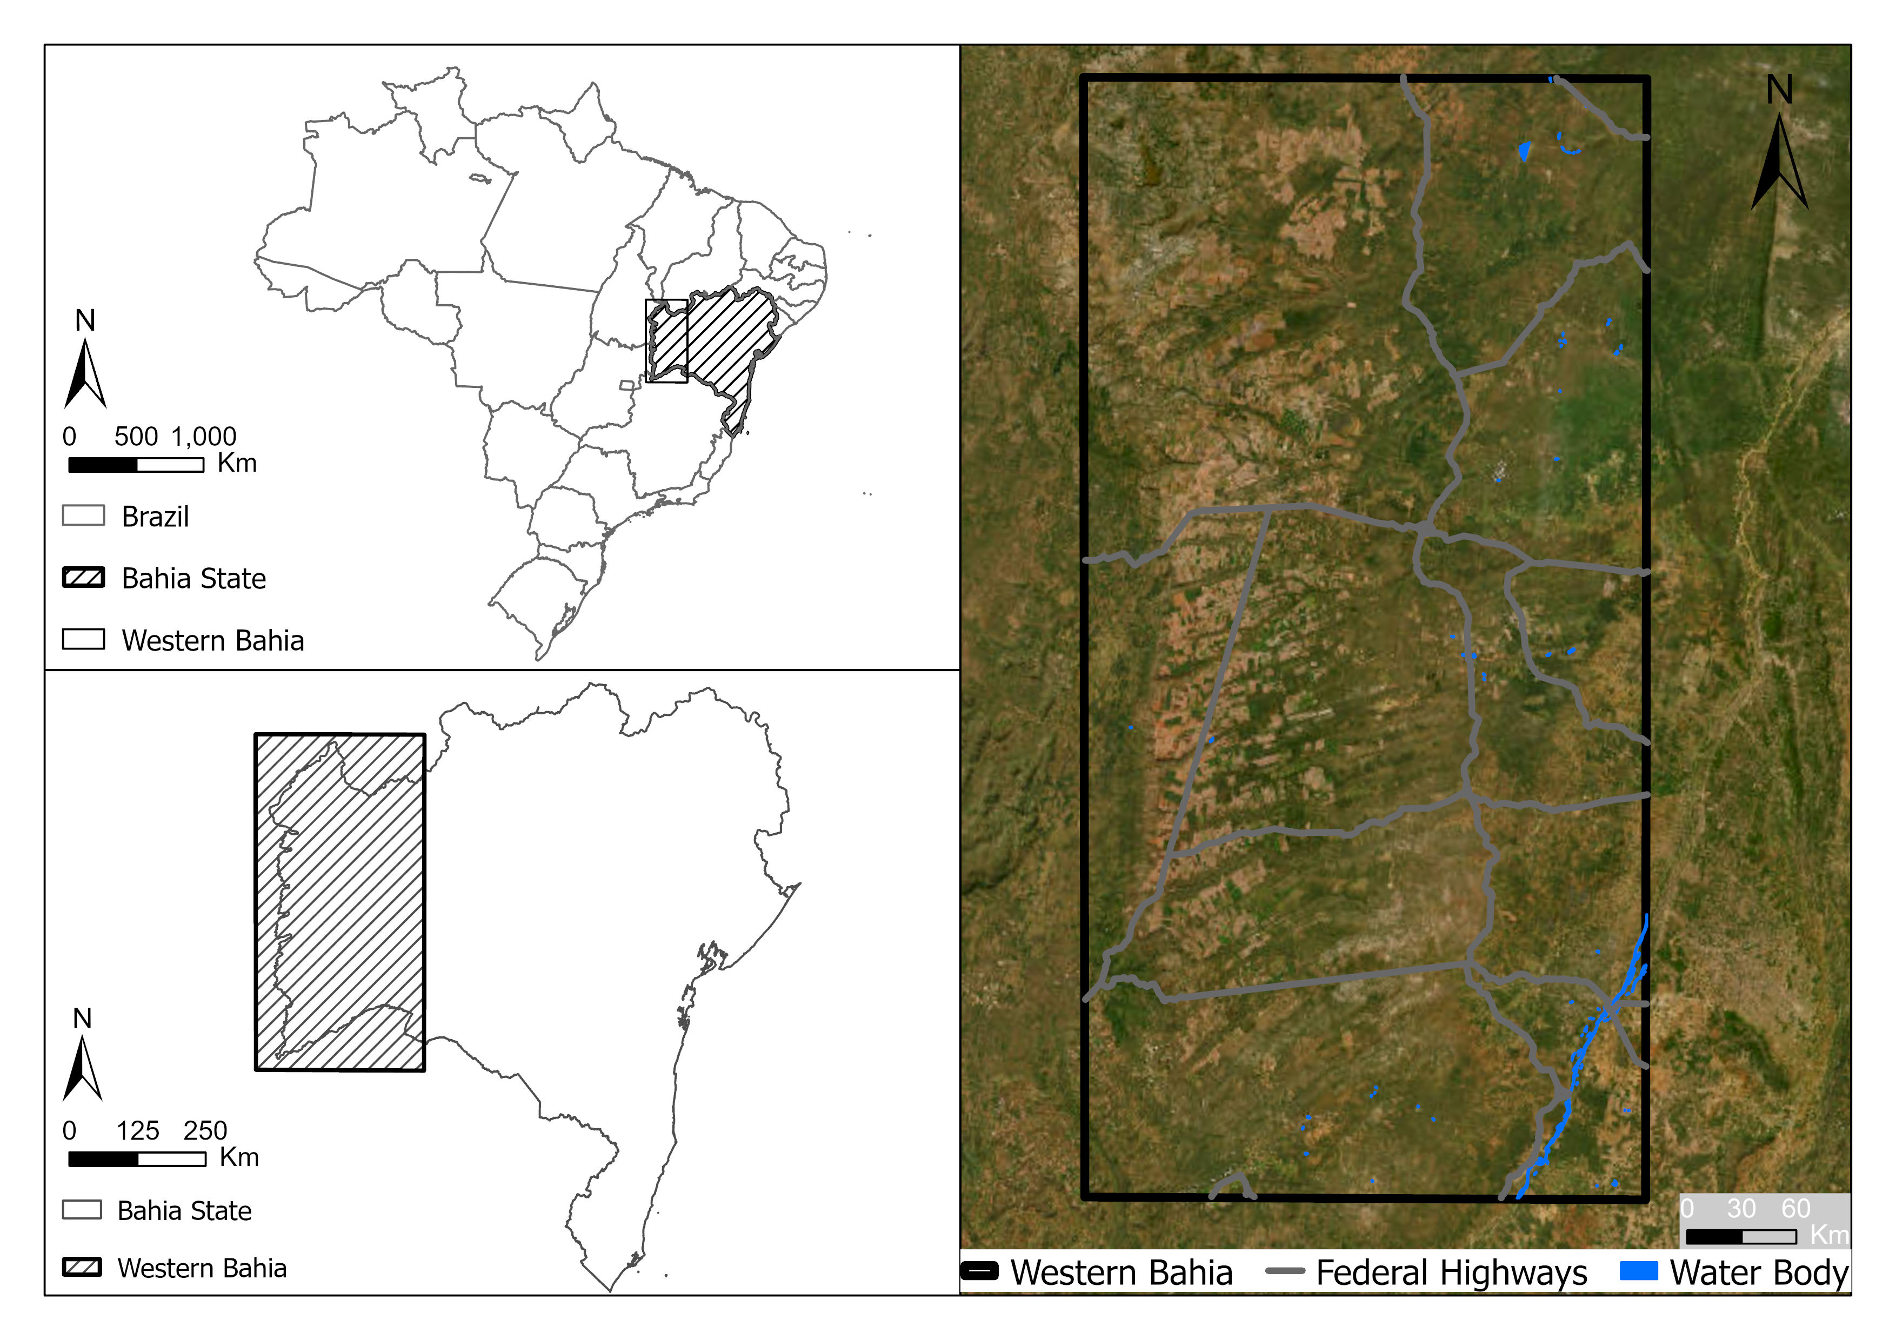
Western Bahia is a hotspot for soybean cultivation.
Pontius Jr, Robert Gilmore, Thomas Bilintoh, Gustavo de L. T. Oliveira, Julia Z. Shimbo. 2023. Trajectories of losses and gains of soybean cultivation during multiple time intervals in western bahia, BRAZIL. Space Week Nordeste. Fortaleza, Brazil.

Slide 9
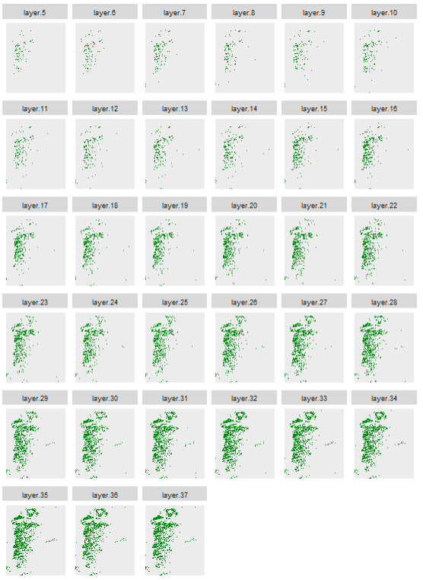
Maps show soybean in western Bahia at 33 years forming 32 time intervals.
Each pixel has more than 8 billion possible combinations of presence or absence of soybean across the 33 years.
2³³ = 8.6 X 10⁹
The challenge is to design graphics so that we can see important patterns and ignore relatively less important patterns.
1989
1990
1991
1992
1993
1994
1995
1996
1997
1998
1999
2000
2001
2002
2003
2004
2005
2006
2007
2008
2009
2010
2011
2012
2013
2014
2015
2016
2017
2018
Presence of soybean
Absence of soybean
2019
2020
2021

Slide 10
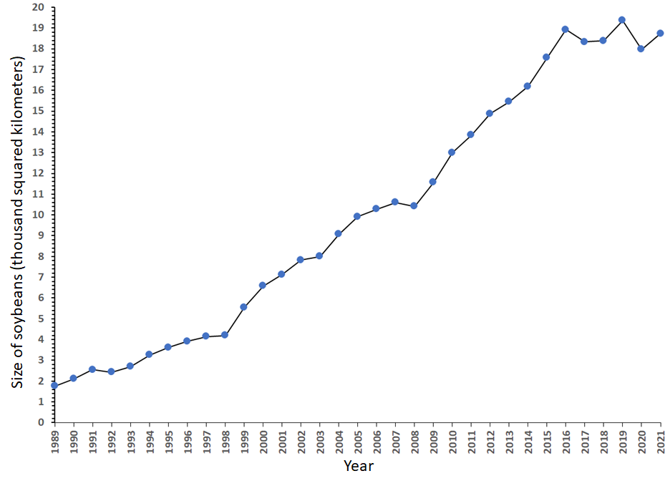
This popular format shows quantity, but fails to show the allocation of gross gain or gross loss.
Three popular equations give different results for annual change percentage, where S₀ is the size at time t₀ and S₁ is the size at time t₁.
Linear Rate = (S₁-S₀)/[(t₁-t₀)S₀]
Exponential Rate base (1+p) = -1 + (S₁/S₀)^[1/(t₁-t₀)]
Exponential Rate base e = Ln(S₁/S₀)/(t₁-t₀)
Area of soybeans versus time in Western Bahia from 1989−2021.

Slide 11
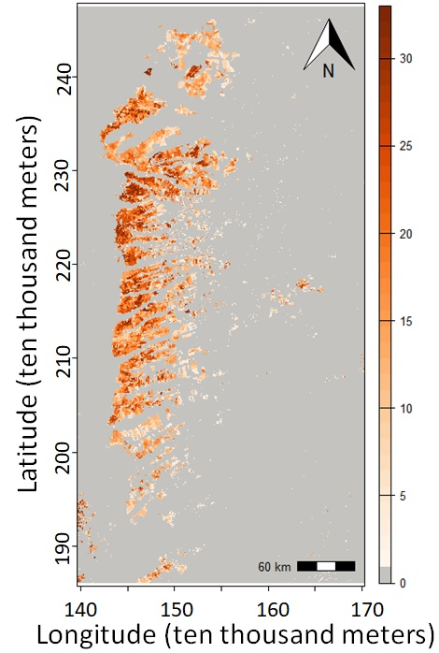
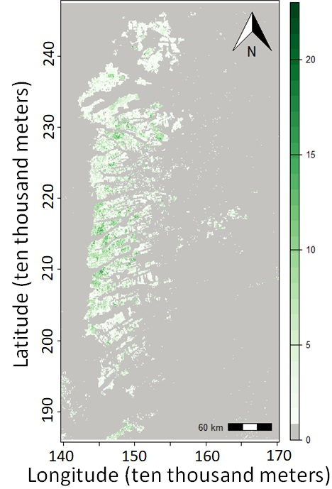
Number of years of presence is on the left and number of changes is on the right. The unified region is the union of pixels that have at least one year of presence.

Slide 12
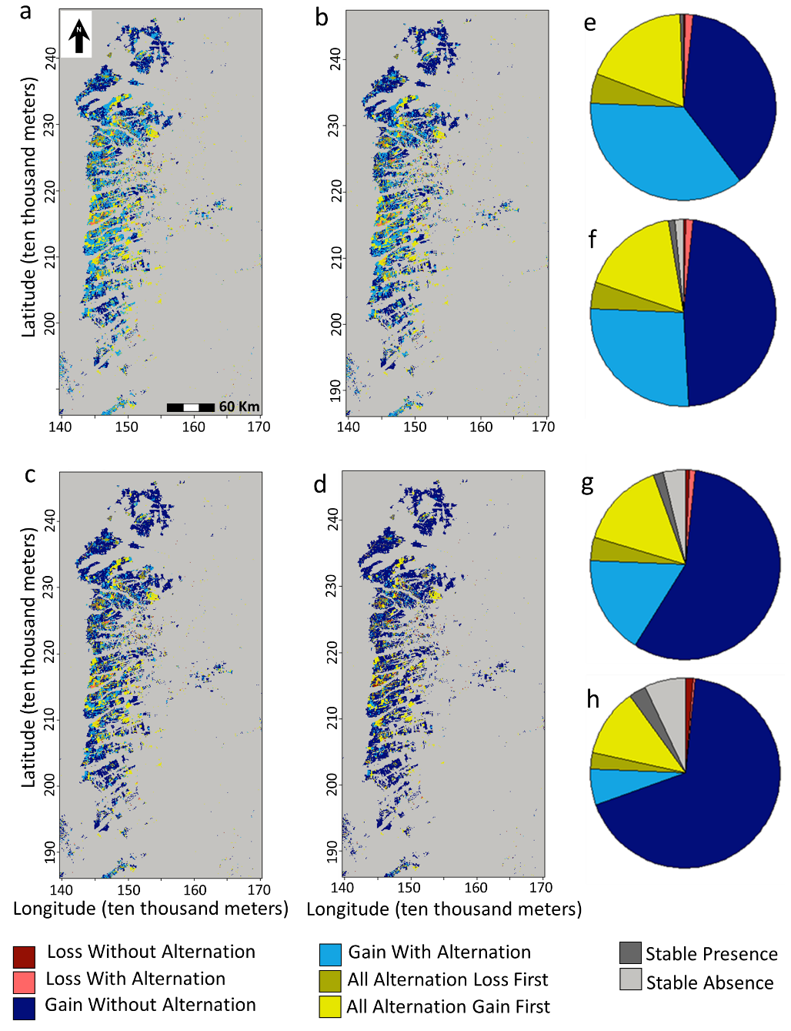
Each pixel is one of eight trajectories during 32 annual time intervals.

Slide 13
Gross Gain is above and Gross Loss below the time axis. Vertical axis units are annual percentage of unified size.

Slide 14
Gross Gain and Gross Loss explain the line graph.
Net change is steep during 1998-1999 because gross gain spikes.
Net change is steep during 1998-1999 because gross loss shrinks.
Area of soybeans versus time
in Western Bahia
during 1989−2021.

Slide 15
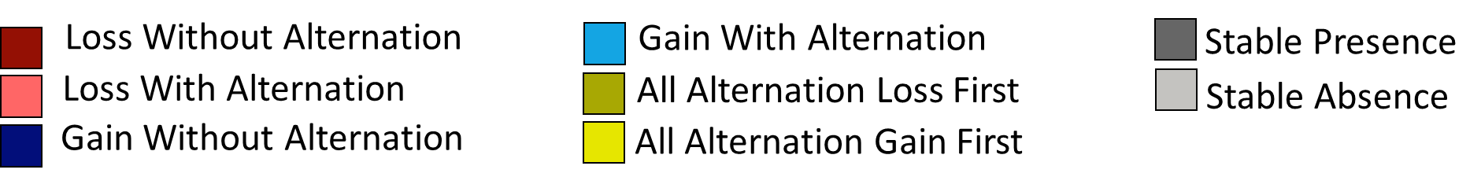
Trajectory Analysis for Temporary Crops
Loss Without Alternation
Gain With Alternation
Stable Presence
Loss With Alternation
All Alternation Loss First
Stable Absence
Gain Without Alternation
All Alternation Gain First

Slide 18
Trajectories of temporary crops at native resolution

Slide 19
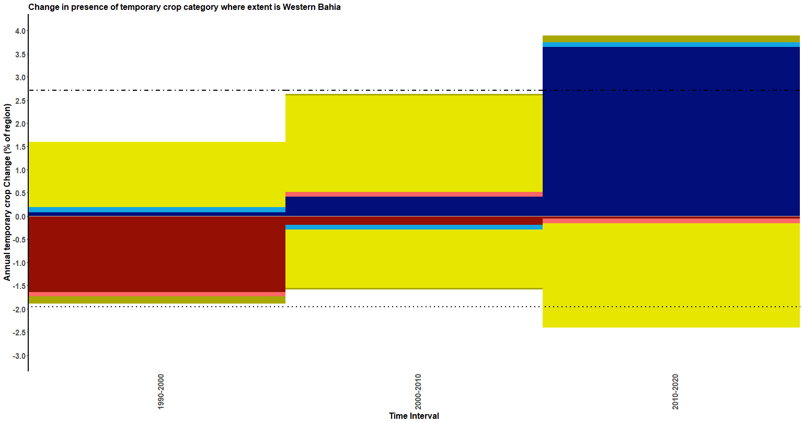

Slide 20
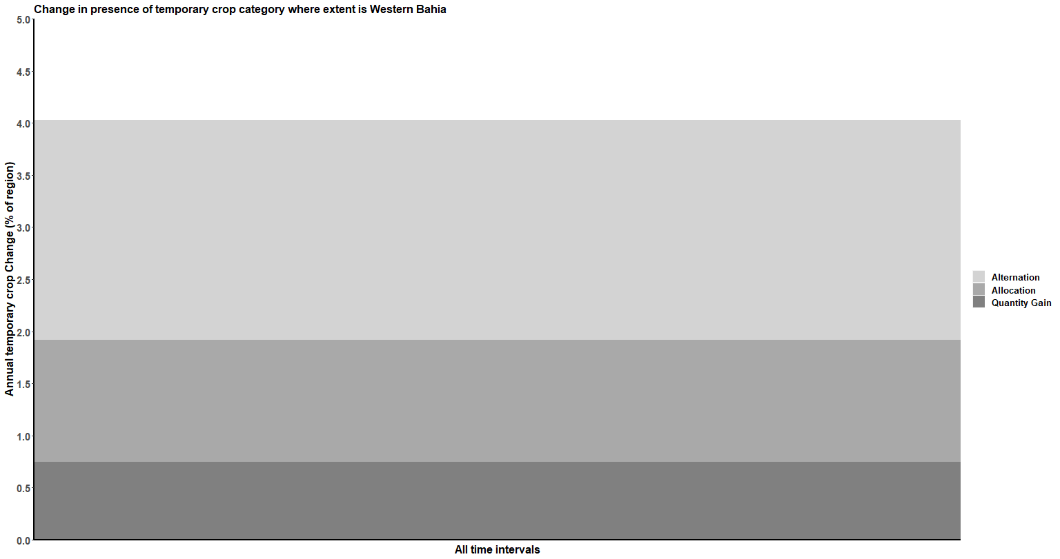

Slide 21
Latitude (ten thousand meters)
Longitude (ten thousand meters)

Slide 24
How to use Bilintoh’s R package
Download the trajectory R package from the GitHub repository at https://github.com/bilintoh/timeseriesTrajectories.
Users must run the following codes in R to install the package:
install.packages("devtools")
library(devtools)
install_github("bilintoh/timeseriesTrajectories")
Thomas Bilintoh | Ph.D. Candidate
Graduate School of Geography | Clark University
Email: tbilintoh@clarku.edu
Portfolio: https://tbilintoh.weebly.com/

Slide 25
Additional Idea for projects
Make a video linked to a Wikipedia site for Kappa the Undead using and designing graphics that Pontius is making with Marco Millones and Tom Francis concerning 200 citations. The analysis reports the citations by the recommendations followed, journal, publisher, country of first author, and number of citations. See these publications, which are at the bottom of the list of publications on our Canvas site:
Stutz et al. 2023 Ch(e)atGPT? An Anecdotal Approach Addressing the Impact of ChatGPT on Teaching and Learning GIScience
Kirchherr 2023 Bullshit in the Sustainability and Transitions Literature: a Provocation
See the Death to Kappa video at https://www2.clarku.edu/faculty/rpontius/videos.html

